Slide 1

Retail Sales
Analysis
By : Mo Amer.

Slide 2
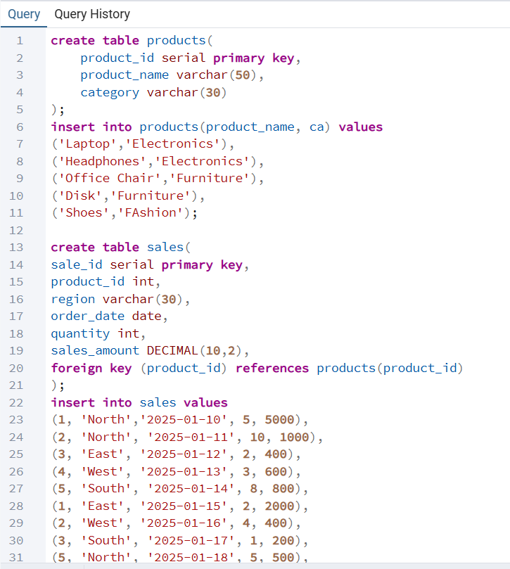
step1: creating the data :
(Products & Actual Sales) by postgreSQL

Slide 3
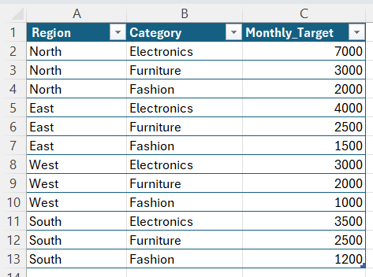
-The second step on creating data :
2.(Target Sales) by Excel

Slide 4
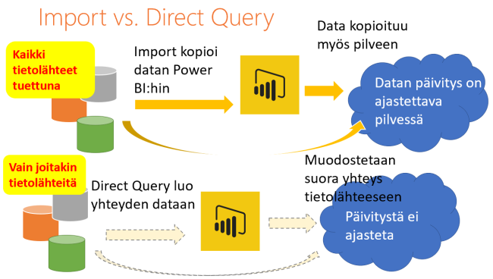
Step 2: importing data and relationships on power bi
There is a problem here !
After importing data, I faced a problem when I was building relationship on Region and Category between (actual sales , target sales);
-there isn’t category column in actual sales table.
-Relationship was many to many between these columns.
Solutions:
1.related category column from public products table.
2. Build dimension tables of category and region to make one to many relationship.
This Photo by Unknown Author is licensed under CC BY-SA-NC

Slide 5
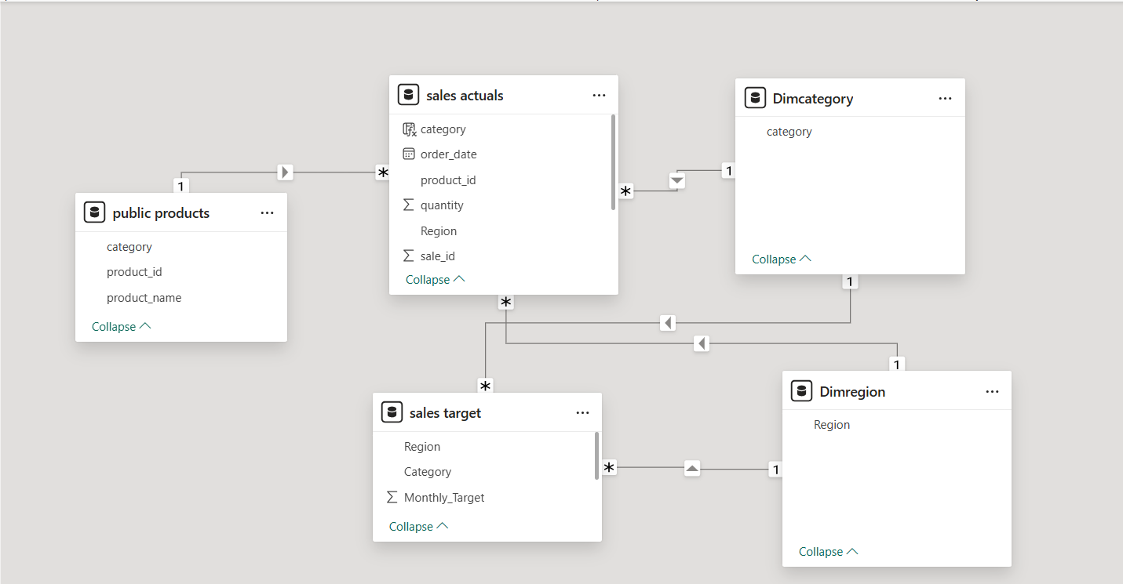

Slide 6
Step 3: Creating measures
Actual Sales measure.
Target Sales measure.
Sales vs Target .
Sales vs Target %.

Slide 7
Step 4: visualizations
I made a table u can see all of important numbers by it.
Chart to see different between sales and targets of any product and category.
KPI to know how much u needed to achieve the target.
Slicers to see all of data that u need.

Slide 8
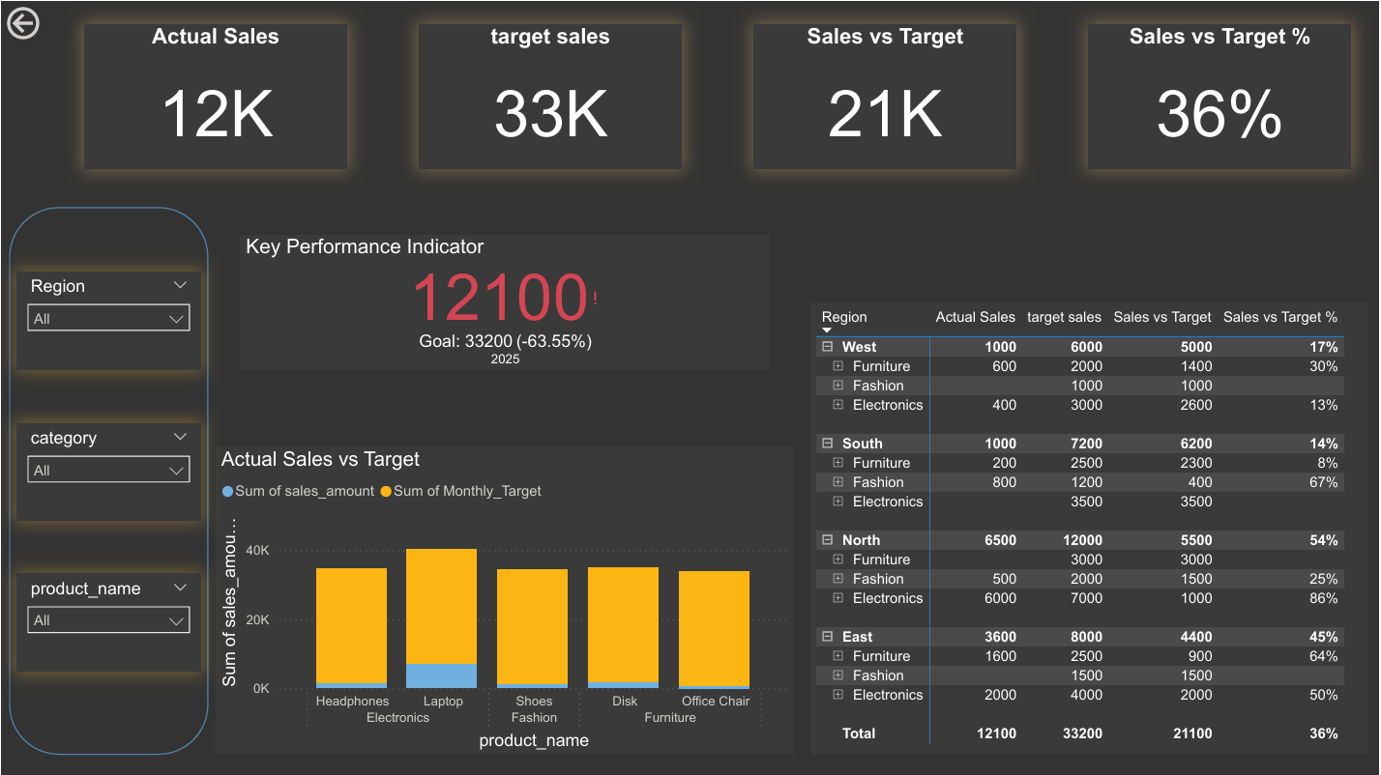

Slide 9

Thank u eng. Abdelhamid for ur effort with me

